Slide 1
ADVANCED THIN FILM
RESEARCH LABORATORY
(2008)
Dr. PhD&Ing. R. M. Oksuzoglu
Faculty of Engineering / Department of Material Science and Engineering
AU-TFG

Slide 2
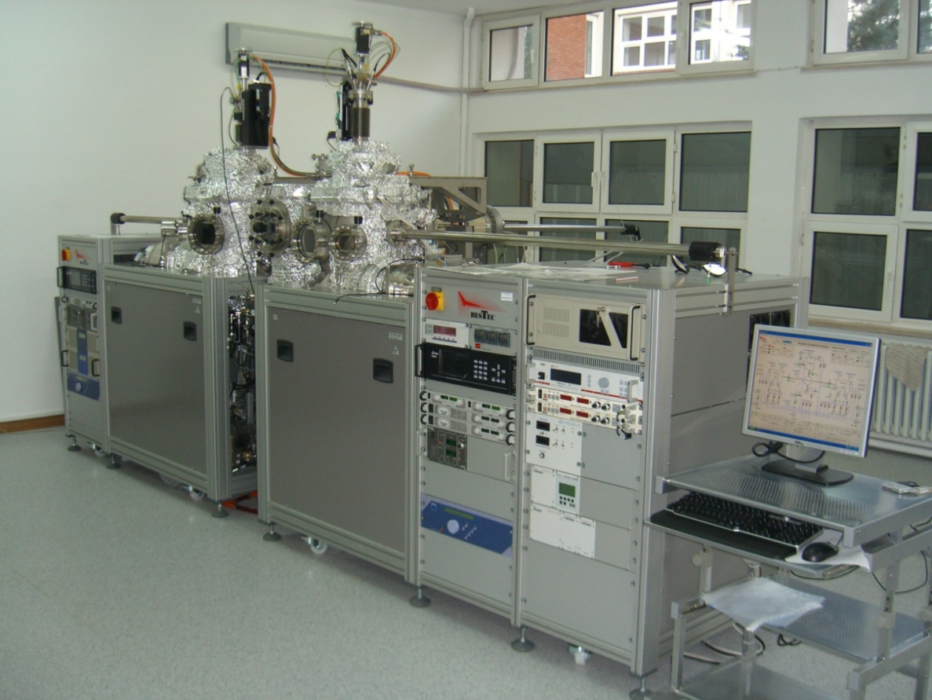
Facilities / Capabilities
Custom-Design UHV Multi-Chamber Sputtering Deposition Tool
Metal Chamber (6 Sources)
Metal-Oxide Chamber (4 Sources and Ion/Atom-Source)
Self-constructed software (up to 100 sequences)
Annealing Chamber (700 °C)
Load Lock (up to 12 samples)
Deposition and Process Techniques
Transfer between chambers
DC&RF-Magnetron
Pulsed DC-Magnetron
Reactive Deposition
DC-Assisted RF-Magnetron
Ion/Atom Insertion
In-Situ-Magnetic Field
In-Situ DC-Bias
Uni-directional Magnetic Field
Annealing
AU-TFG

Slide 3
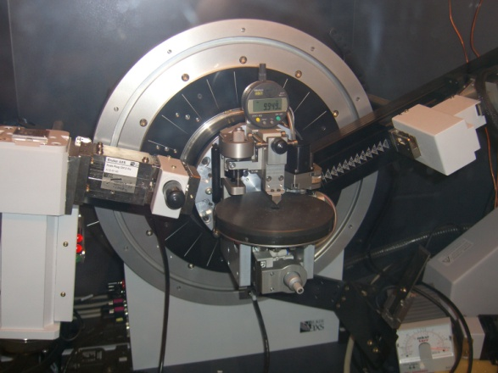
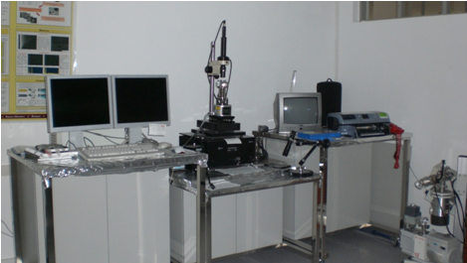
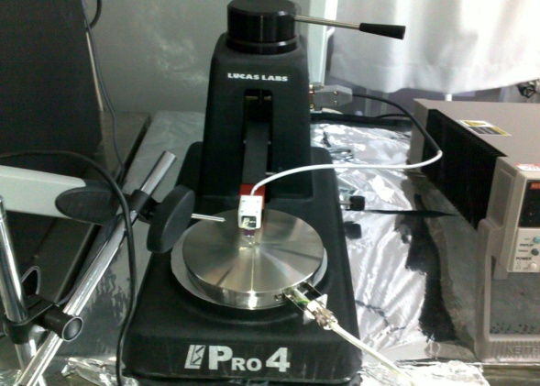
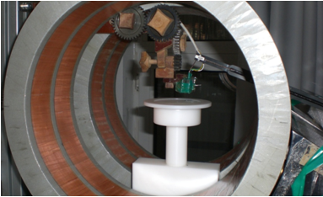
Facilities / Capabilities
Structural, Electrical and Magnetic Characterization
X-Ray Diffractometer (up to 4 inch wafers)
Scanning Probe Microscopy (SPM, AFM, LFM)
Surface Profiler (up to 4 inch wafers)
Four Point Probe station with heating stage
Helmholtz Coil (Magnetoresistance)
New Tools (Pending): Combination of
Vibration Sample Magnetometer- AND
Micro-Probe Electrical Transport-Systems
AU-TFG

Slide 4
Sputtering and Deposition Parameters
Base Pressure of Deposition Chamber (Torr)
Deposition Pressure (mTorr)
Deposition Flow (Ar-sccm)
Deposition Power (Watt)
Partial Pressures (Ar-O₂-N₂)
Working Distance (h)
Working Angle (Φ, θ)
Depositon rate (nm/s)
Uniformity (h, r, l )
Rotation Speed of Substrate (rpm)
Substrate Temperature (°C)
Techniques depending on the Materials:
Metallic: DC-Sputtering
Semiconductor: DC or RF Sputtering
Insulator: RF-Sputtering
AU-TFG

Slide 5
Research Areas /1
THIN FILM STRUCTURES AND SYSTEMS (NANO-MAGNETISM)
Spin Valves
Ta/Ru/Ta/NiFe/Pt-IrMn/CoFe/Ru(/CoFeB/New-Barrier (0.8 – 1.5nm)/ CoFeB/Ta/Ru/Au
Ta/Ru/Ta/IrMn/CoFeB/New-Barrier (0.8 – 1.5nm)/CoFeB/Ta/Ru/Au
Exchange Bias
Seed-Layer/IrMn/Interface-Modification/CoFe/Ta
New Seed-Layer/IrMn/CoFe/Ta
SUBJECTS
Magnetoresistance Random Access Memory (MRAM), Read Heads and Position sensors
Giant&Tunnel Magnetoresistance (GMR&TMR)
Resistance-Area Product (RA)
Thermal Stability

Slide 6
Sputter Deposition Conditions and Parameters for Simple Spin Valve Sensors
DC
DC-Pulsed
RF
Base Pressure (Torr)
Deposition Pressure (mTorr)
Deposition Flow (Ar-sccm)
Deposition Power (Watt)
Partial Pressures (Ar-O₂-N₂)
Working Distance (h)
Working Angle (Φ)
Depositiın rate (nm/s)
Uniformity (h, r)
Rotation Speed of Substrate (rpm)
Substrate Temperature (°C)
Deposition Technique
Cap Layer
FreeLayer (FM)
DC
DC-Pulsed
Reactive
RF
Cu, Mg or Al-Oxide
Pinning Layer
AFM Layer
DC
DC-Pulsed
RF
Under Layers
For each layer
6 – 9 Parameters
For a Simple Spin Valve
42 – 63 Parameters
AU-TFG

Slide 7
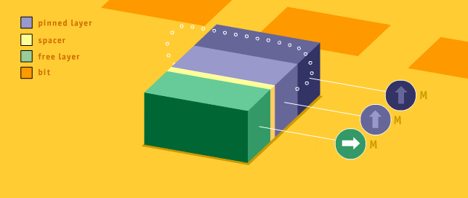
Spin Valve Systems (GMR&TMR) for
Terabyte Memories in Smart-Electronics
GMR | TMR
- Cu (CIP) , CuOx (CPP) | - AlO_{x} veya MgO (CPP)
- Spin dependent scattering | Polarization Difference between electrodes
- ≈ % 15 MR [1] | - ≈ % 600 MR [2]
MR (%) = (ρ_{AP} – ρ_{P}) / ρ_{P}
Cap Layer
Ta/Au (15nm)
CoFeB (2nm)
Free Layer
Barrier Layer
Pinned Layer
CoFeB (2nm)
Pinning Layer
IrMn/CoFe/Ru (13nm)
[1] S. Jo, M. A. Seigler, J. Magn. Magn. Mater., 316, 93-97 (2007)
[2] Ikeda et al., Appl. Phys. Lett., 93, 082508 (2008)
Seed Layer
NiFe (8nm)
sıkıştırılmış tabaka
ayırıcı tabaka
serbest tabaka
bit
Buffer Layer
Ta /Ru/Ta (35nm)
Substrate
* http://www.research.ibm.com/research/gmr.html
AU-TFG

Slide 8
Research Highlights /1
Exchange Bias in Spin Valve Systems
Small-Angle X-Ray Diffraction
Ta
CoFe
PtMn
Ta/NiFeCr/Ru
Magnetic Hysteresis – Theoretical Fitting
X-Ray Reflectivity-Simulations
Ta
CoFe
IrMn
Ta/NiFe

Slide 9
Research Areas /2
THIN FILM STRUCTURES AND SYSTEMS (OPTIC)
Metal Oxide Semiconductors
Si/SiO₂/TiMgOx
Si/SiO₂/VOx/V
Quartz/VOx
SUBJECTS
Microbolometers (ASELSAN-MGEO, Turkey)
Optical Switch
Non-linear Optic (Cooperation with University – Ankara, Turkey)

Slide 10
Spin Valve and VOx Structures
Cap Layer
Ta/Au (15nm)
CoFeB (2nm)
Free Layer
Barrier Layer
CoFeB (2nm)
Pinned Layer
Total Thickness
~ 100 nm
IrMn/CoFe/Ru (13nm)
Pinning Layer
VOx
Seed Layer
NiFe (8nm)
Buffer Layer
Ta /Ru/Ta (35nm)
Substrate
VOx < 100 nm is desired for CMOS
10
AU-TFG

Slide 11
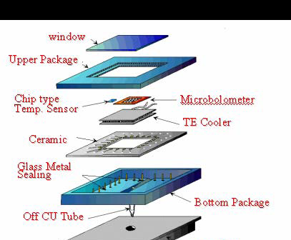
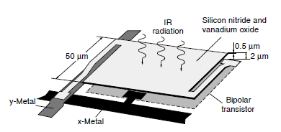
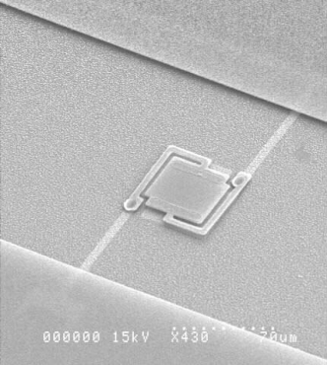
Uncooled Microbalometers: Infrared detectors
Bridge structure of Honeywell microbolometer
In micromachining fabrication of CMOS thin films
The reproducible phase and composition and morphology at low process temperature (<400 ºC)
Film thickness uniformity
Optimization of TCR & resistivity products
Dai, X. Z. Wang, S. W. He et al., “Low temperature fabrication of VOx thin films for uncooled IR detectors by direct current reactive magnetron sputtering method,” Infrared Physics & Technology, vol. 51, no. 4, pp. 287-291, March 2008.
R.A. Wood, C.J. Han, P.W. Kruse, Integrated uncooled IR detector imaging arrays, Proceedings of IEEE SolidState Sensor andActuator Workshop, 132–135, Hilton HeadIsland , S.C., (June, 1992).

Slide 12
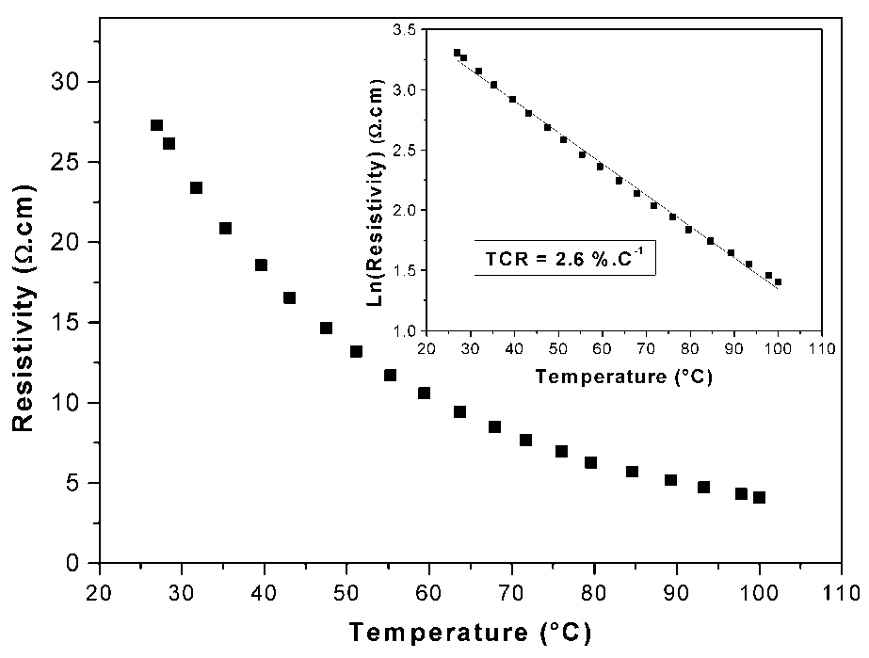
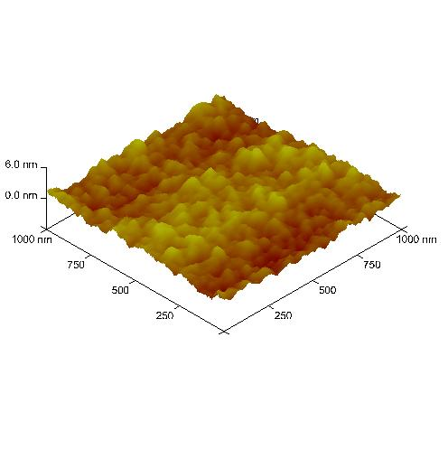
Research Highlights /2
Temperature Coefficient Resistivity
Atomic Force Microscopy
VOx(50nm)
(a) 4 ns and (b) 65 ps pulse durations excitations at several intensities

Slide 13
Collaborations
Institute of Material Sciences, Technical University Darmstadt, Germany
Physics of Nanostructures, Technical University Bielefeld, Germany
University Ankara – Non-Linear Optic Research Lab., Turkey
Institute of Materials Science and Nanotechnology (UNAM), Turkey
Gebze Institute of Technology, Nanomagnetism Lab. Turkey
Different Groups within Anadolu University
Financial Supports
The Scientific and Technological Research Council of Turkey (TUBITAK)
Prime Ministry State Planning Organization (DPT)
Anadolu University Research Fund (AU-BAP)
ASELSAN-MGEO

Slide 14
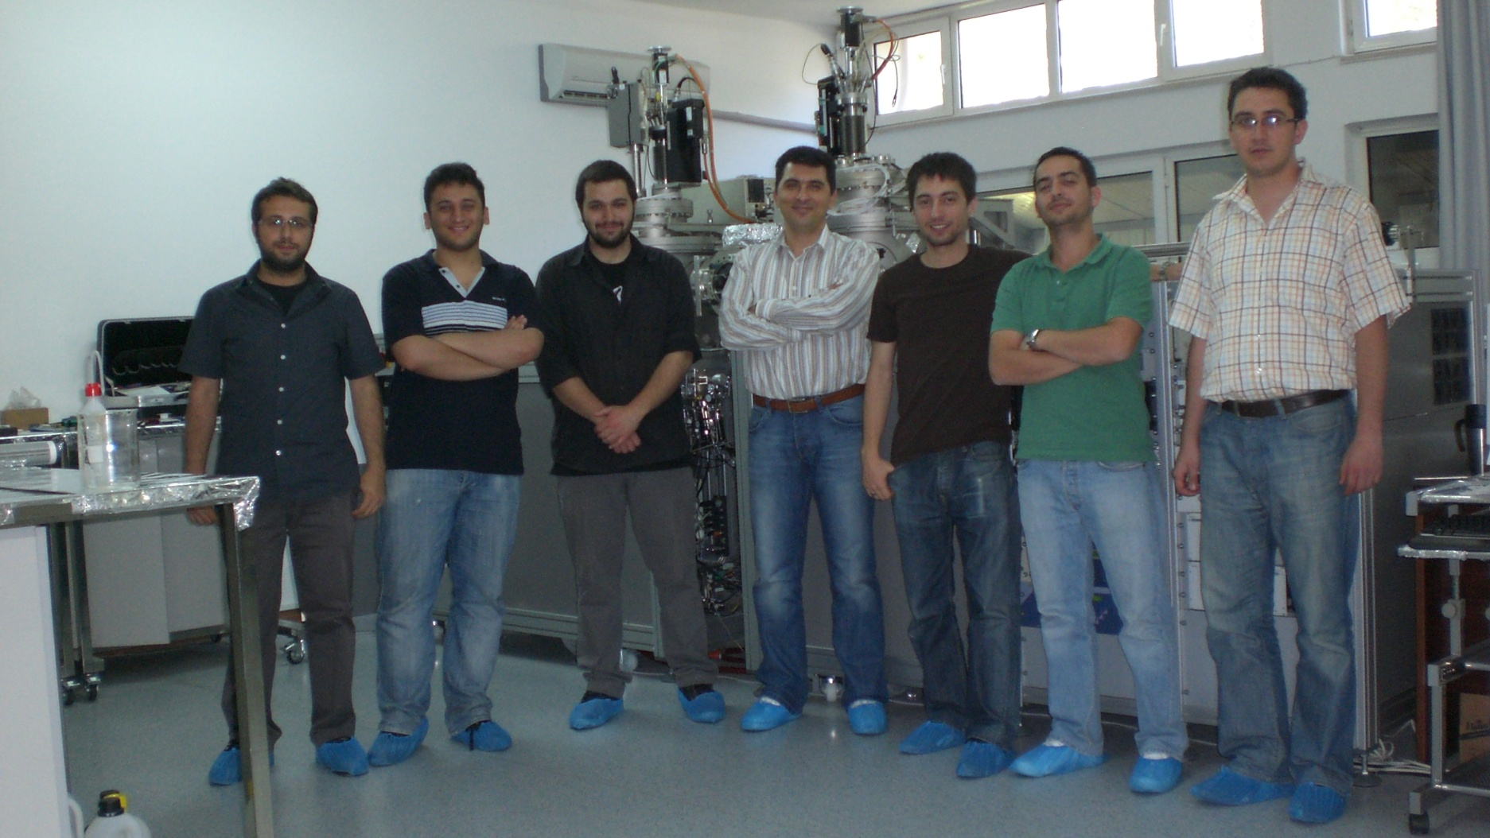
People and Contact Info
Dr. PhD. & Ing. Ramis Mustafa OKSUZOGLU
rmoksuzoglu@anadolu.edu.tr
Ph.D Candidates
Mustafa Yıldırım
MSc Students
Murat Yağcı
Sami Pekdemir
Elif Gül Özkan
Okan Deniz (graduated)
Pınar Bilgiç (graduated)
Ogeday Çapar (graduated)
Hakan Çınar (graduated)
Phone: +90 222 321 3550 ext. 6345 and 6382
Fax: +90 222 323 95 01
http://home.anadolu.edu.tr/~rmoksuzoglu

Slide 15
Thank you for your attention!

